Slide 1
Ethics and Data Science
It matters.

Slide 2
Ethics is complicated
Many ethical issues are complex and don’t have clear or easy answers.
I’m not here to tell you what to do or provide answers.
It’s good to think about how you’d handle a situation BEFORE you are in it.
Volkswagen engineer sentenced to prison for creating software to cheat on emissions tests (he was following his boss’s orders)

Slide 3
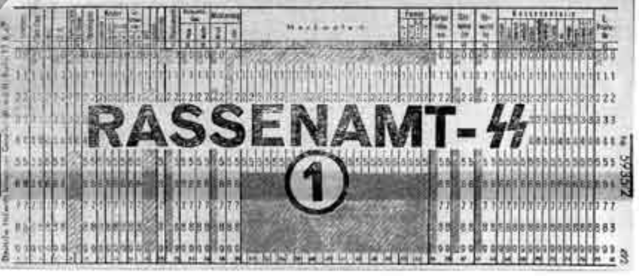

In the concentration camps, IBM's code for Jews was 8. Its code for Gypsies was 12. General executions were coded as 4, death in the gas chambers as 6. Only Jews and Gypsies were systematically murdered in gas chambers.
The Swiss judge ruled "It does not thus seem unreasonable to deduce that IBM's technical assistance facilitated the tasks of the Nazis in the commission of their crimes against humanity, acts also involving accountancy and classification by IBM machines and utilized in the concentration camps themselves."
“To the blind technocrat, the means were more important than the ends. The destruction of the Jewish people became even less important because the invigorating nature of IBM's technical achievement was only heightened by the fantastical profits to be made at a time when bread lines stretched across the world.”

Slide 4
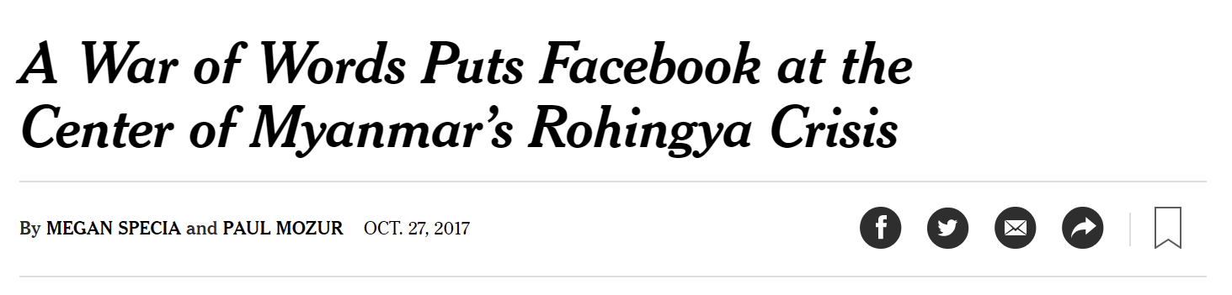
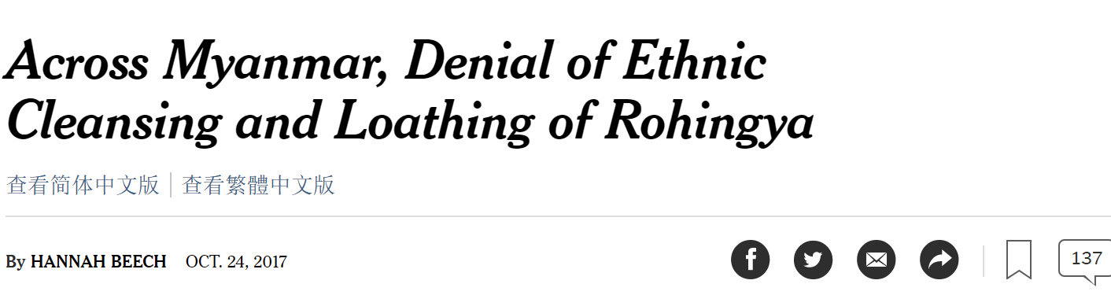
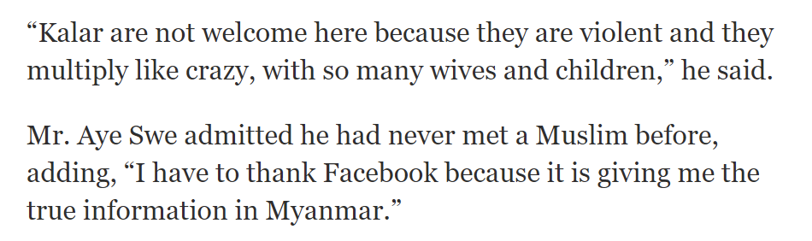

Slide 5
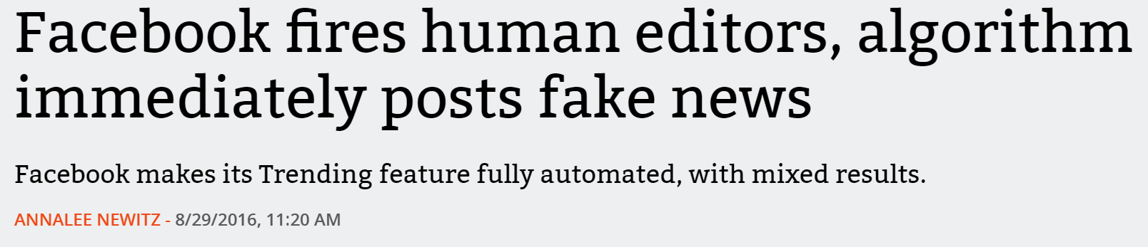
Myth of neutral platforms
Revenue model
Design: do friends’ posts, sponsored content, etc have same format
Controls and filters available to users, available to advertisers
Experiments
Whether to have human moderators & how many
Who gets banned

Slide 6
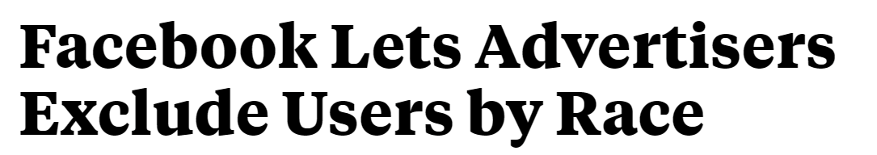
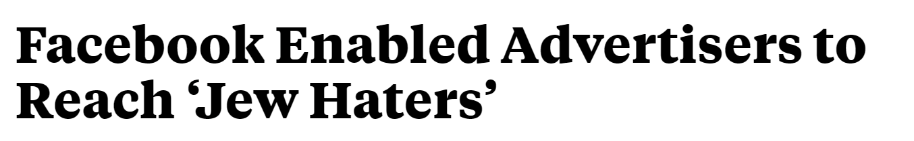
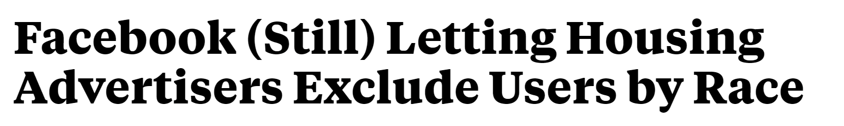
Oct 2016:
Sept 2017:
Nov 2017:

Slide 7
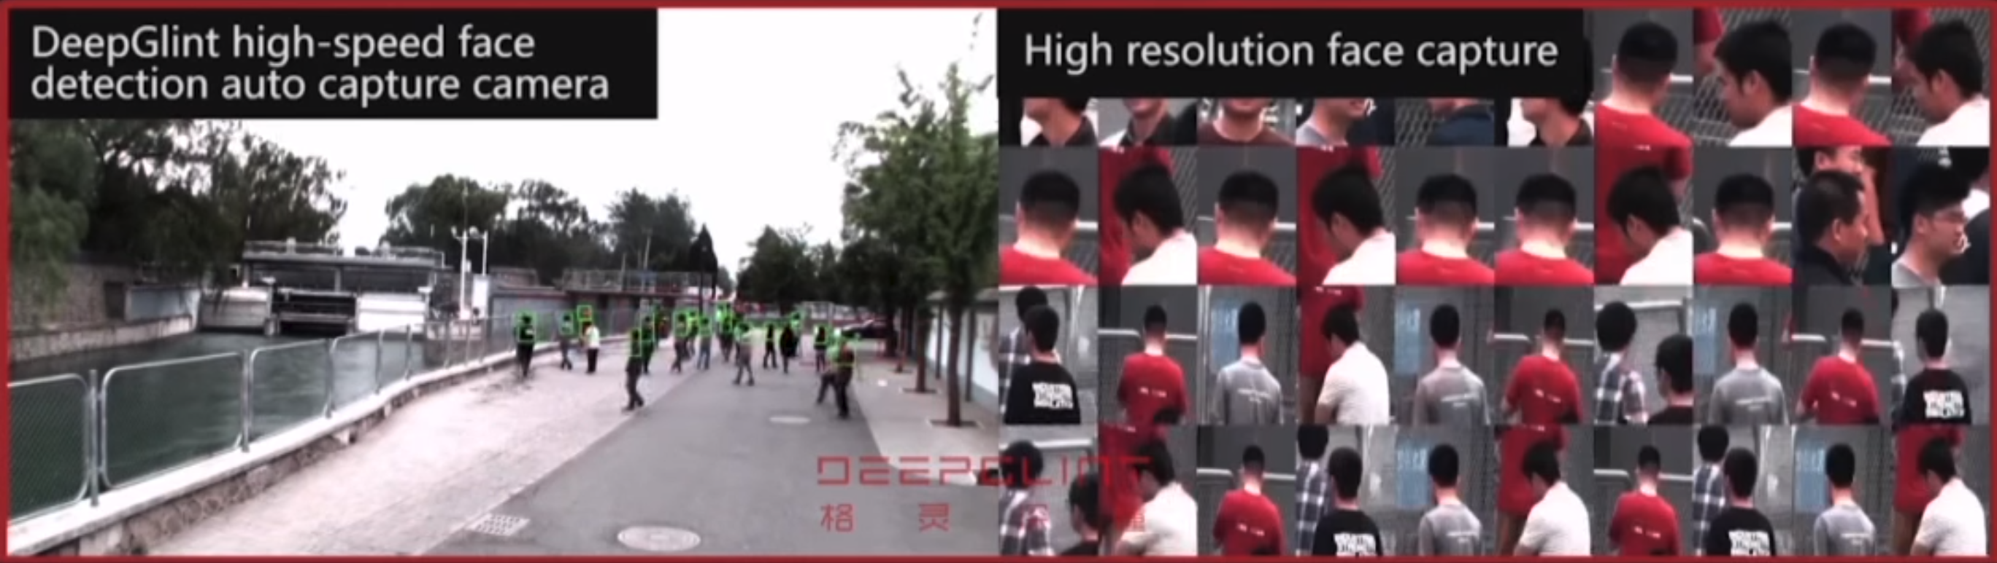
Unintended consequences
Consider how your tech could be used:
By trolls, harassers
By authoritarian governments for surveillance
For propaganda or disinformation

Slide 8
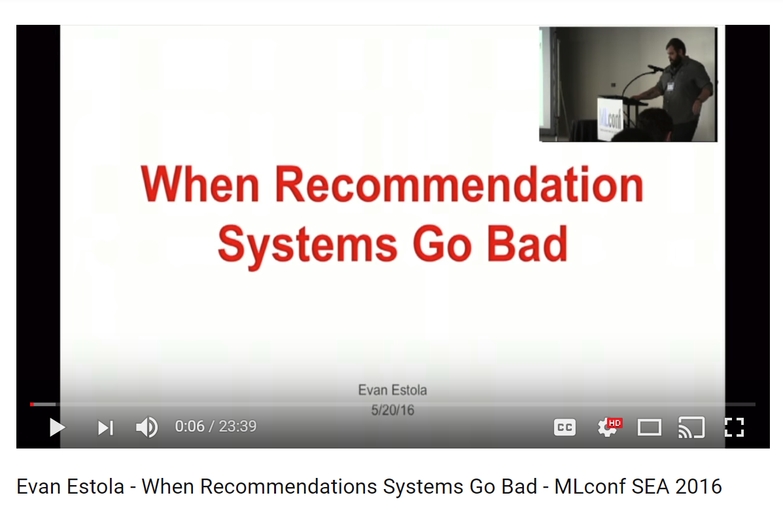
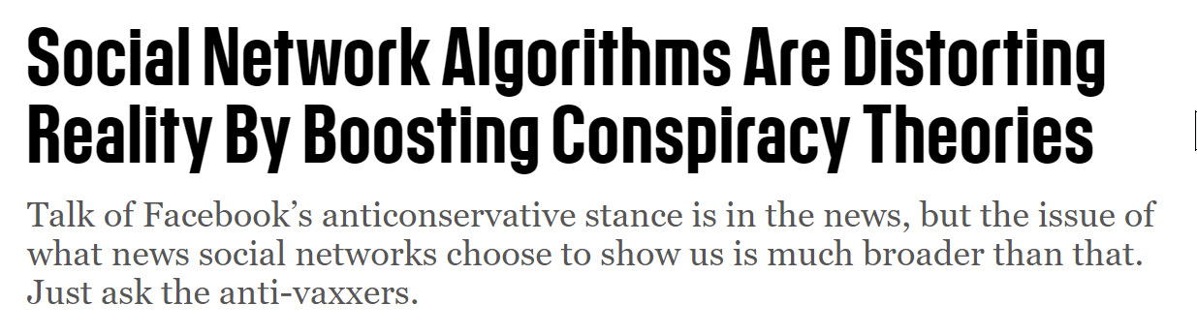
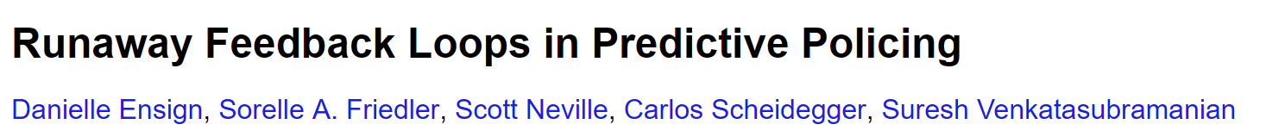
Runaway feedback loops

Slide 9
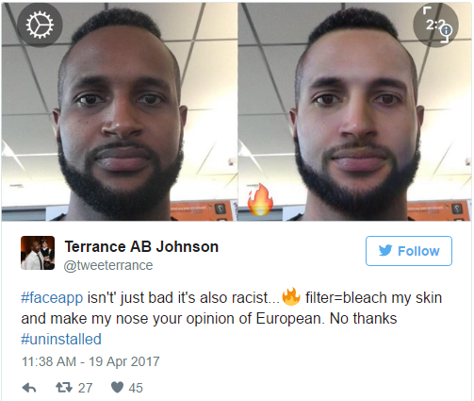
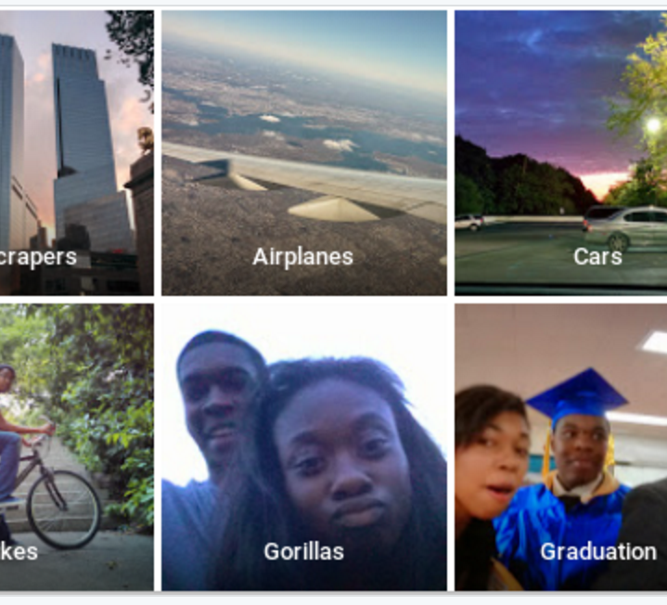
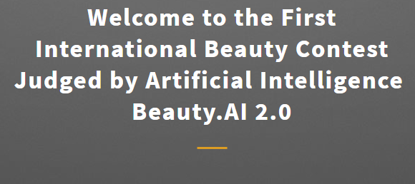
Bias in Image Software

Slide 10
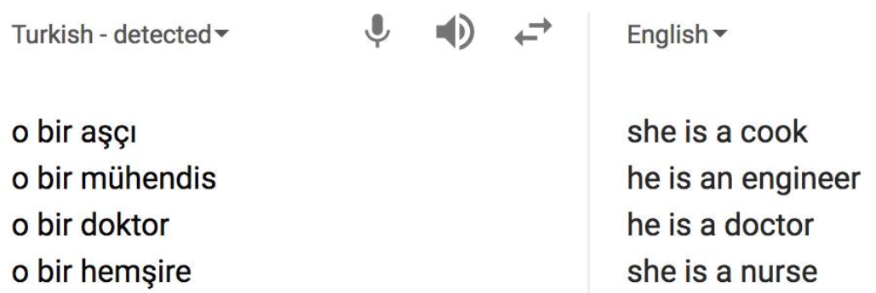
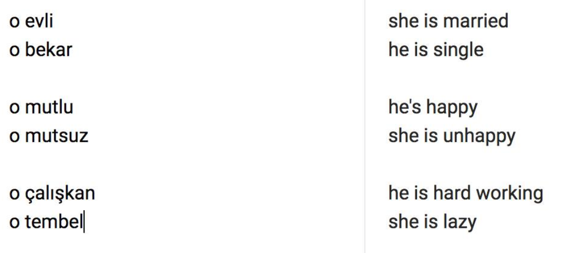
System for restaurant reviews ranked Mexican restaurants lower, because word embeddings had negative connotations with “Mexican”
Word embeddings improve web search results. What if searching for “grad student neural networks” more likely to return male names?

Slide 11
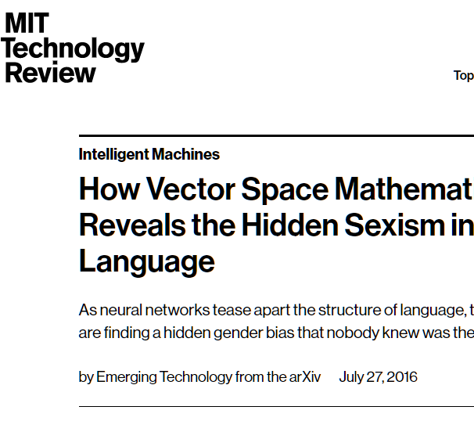
Father → Doctor ::
Mother → Nurse
Man → Computer Programmer :: Woman → Homemaker

Slide 12
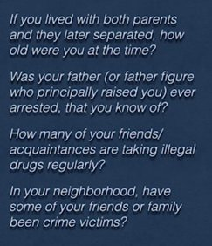
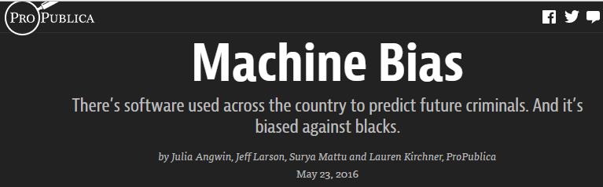
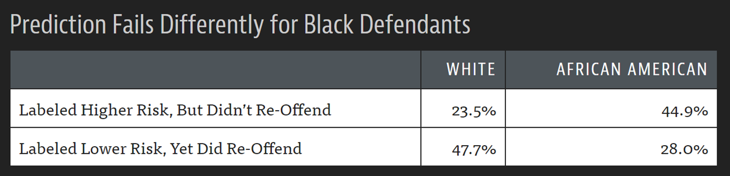
Bias in AI: offensive to tragic
Abe Gong

Slide 13
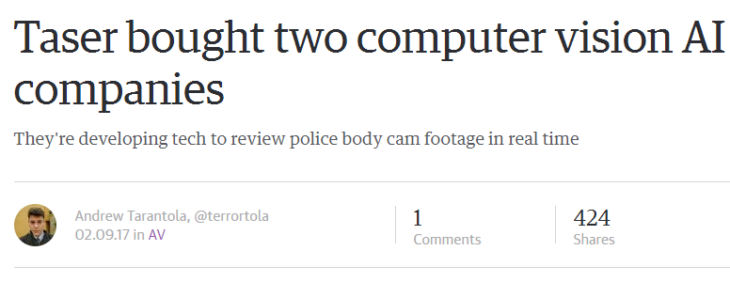
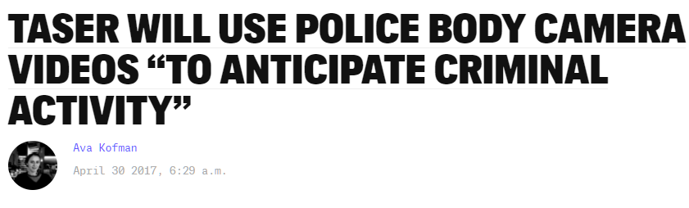
Taser AI, no transparency
???
Failure of Computer Vision on PoC
Racial Bias in Policing & Police Data
Notes:
quote: Nondisclosure agreements allow private companies like Taser to defend their proprietary computing systems from public scrutiny, Joh explained. “Typically we think we have oversight into what police can do,” said Joh. “Now we have third-party intermediary, they have a kind of privacy shield, they’re not subject to state public record laws, and they have departments sign contracts that they are going to keep this secret.”
Quote: Crime reporting, contact cards, and arrest rates are not neutral

Slide 14
Questions to ask about AI
What bias may be in the data?
How diverse is the team that built it?
Can the code and data be audited?
Are they open source?
What are error rates for different sub-groups?
What is the accuracy of a simple rule-based alternative?
What processes are in place to handle appeals or mistakes?

Slide 15
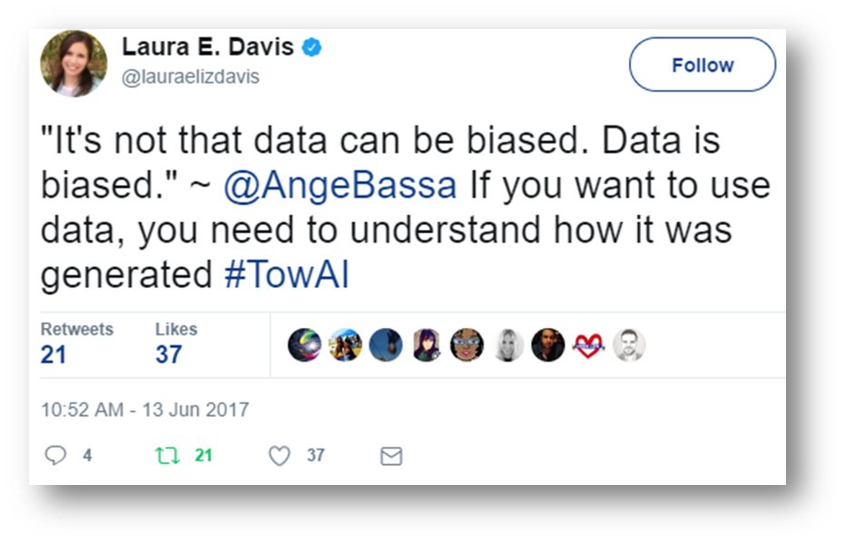
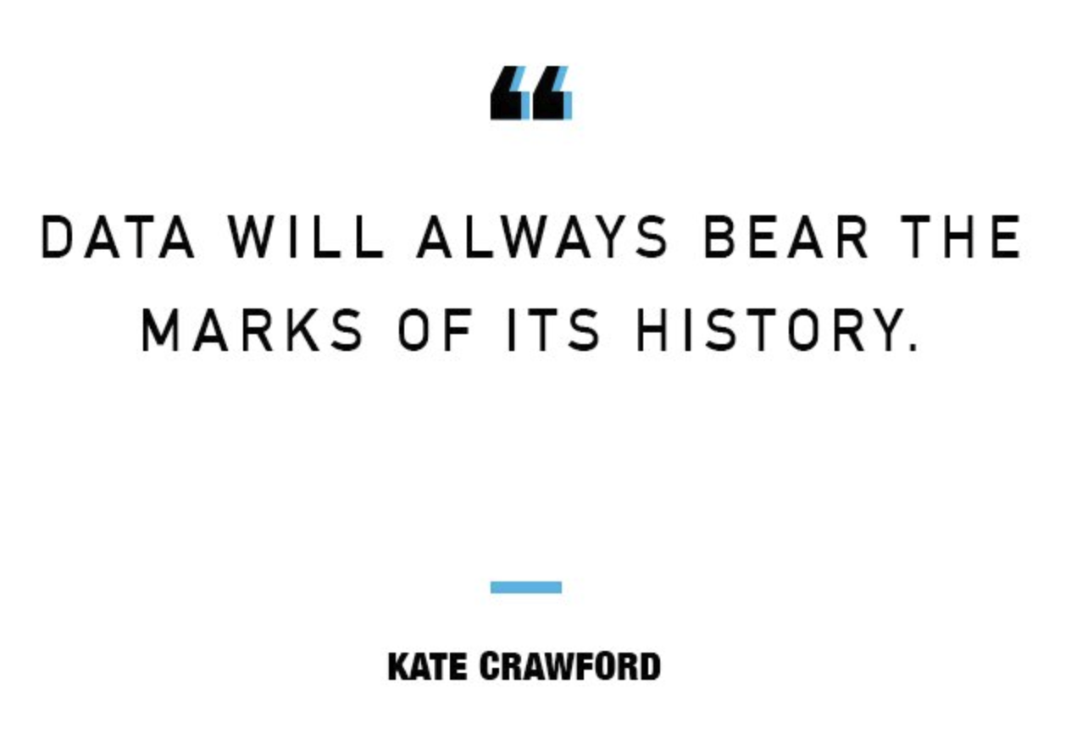

Slide 16
You have options!
Only 0.3-0.5% of the global population knows how to code
You are in demand (even when it doesn’t feel that way. Also getting your 1st job is the hardest)

Slide 17
Your responsibility in hiring
Diverse teams perform better
Believing you are meritocratic/“gender-blind”/“color-blind” INCREASES bias
Doing a good job as an interviewer takes thought & preparation
Don’t have to be a manager to make change: Stripe engineer Julia Evans created a rubric just for herself, later adapted by all of Stripe

